Slide 1
Statistical Analysis

Slide 2
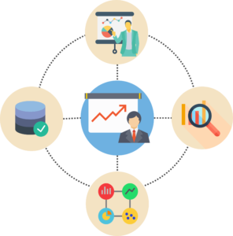
Overview of Statistics
Statistics is a Mathematical Science pertaining to data collection, analysis, interpretation and presentation.

Slide 3
Overview of Statistics
Statistics is used to process complex problems in the real world so that Data Scientists and Analysts can look for meaningful trends and changes in Data.
In simple words, Statistics can be used to derive meaningful insights from data by performing mathematical computations on it.
Several Statistical functions, principles, and algorithms are implemented to analyze raw data, build a Statistical Model and infer or predict the result.

Slide 4
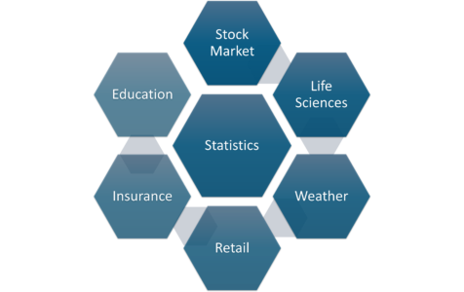
Overview of Statistics
The field of Statistics has an influence over all domains of life, the Stock market, life sciences, weather, retail, insurance, and education are but to name a few.

Slide 5
Business Statistics
Business statistics is the application of statistics to analyze business data.
Companies use business stats for forecasting, testing correlations, and describing data.
A career in business statistics can be a good choice for people with strong math skills.

Slide 6
Business Statistics
Imagine you have a sweater factory and don't know how many sweaters to make. If you make too many, you're wasting money, and if you make too few, you're missing the opportunity to sell more. So how do you find the perfect number? Business statistics has the answer.

Slide 7
Business Statistics
Professionals in the field of business statistics apply statistical methods to answer business questions. This could mean describing a complex financial situation, predicting customers' behavior, or determining if an ad campaign is working to drive sales.

Slide 8
Overview of Statistics
Terminologies in Statistics - Statistics for Data Science
One should be aware of a few key statistical terminologies while dealing with Statistics for Data Science. I’ve discussed these terminologies below:
The population is the set of sources from which data has to be collected.
A Sample is a subset of the Population
A Variable is any characteristics, number, or quantity that can be measured or counted. A variable may also be called a data item.
Also known as a statistical model, A statistical Parameter or population parameter is a quantity that indexes a family of probability distributions. For example, the mean, median, etc. of a population.

Slide 9
Block 1
Primary and Secondary Data
The data is divided into two categories based on the source from which they’re obtained. The primary data is the data that is collected first hand. They are often collected through field surveys, questionnaires etc.
The secondary data is the data that is obtained from the journals and other databases that are usually prepared and available as open-source data.

Slide 10
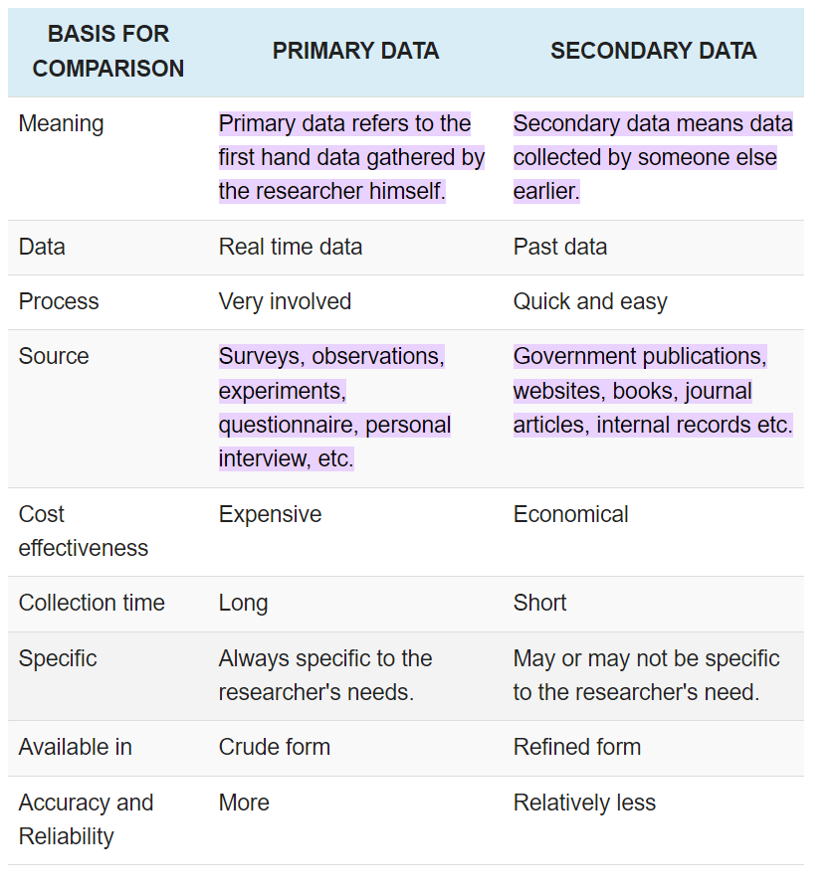
Block 1

Slide 11
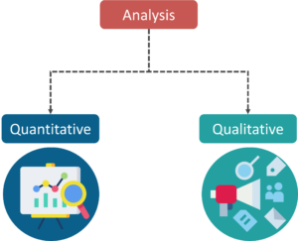
Overview of Statistics
Types of Analysis
An analysis of any event can be done in one of two ways:

Slide 12
Overview of Statistics
Quantitative Analysis: Quantitative Analysis or Statistical Analysis is the science of collecting and interpreting data with numbers and graphs to identify patterns and trends.
Qualitative Analysis: Qualitative or Non-Statistical Analysis gives generic information and uses text, sound and other forms of media to do so.
For example, if I want a purchase a coffee from Starbucks, it is available in Short, Tall and Grande. This is an example of Qualitative Analysis . But if a store sells 70 regular coffees a week, it is Quantitative Analysis because we have a number representing the coffees sold per week.

Slide 13
Overview of Statistics
Categories in Statistics
There are two main categories in Statistics, namely:
Descriptive Statistics
Inferential Statistics

Slide 14
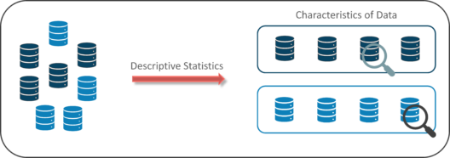
Descriptive Statistics
Descriptive Statistics uses the data to provide descriptions of the population, either through numerical calculations or graphs or tables.
Descriptive Statistics helps organize data and focuses on the characteristics of data providing parameters.

Slide 15
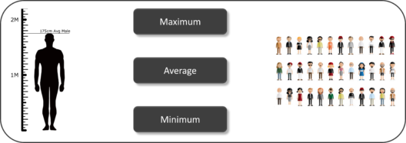
Descriptive Statistics
Suppose you want to study the average height of students in a classroom, in descriptive statistics you would record the heights of all students in the class and then you would find out the maximum, minimum and average height of the class.

Slide 16
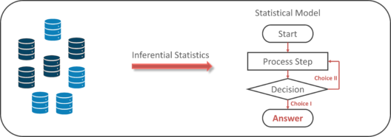
Inferential Statistics
Inferential Statistics makes inferences and predictions about a population based on a sample of data taken from the population in question.
Inferential statistics generalizes a large data set and applies probability to arrive at a conclusion. It allows you to infer parameters of the population based on sample stats and build models on it.

Slide 17
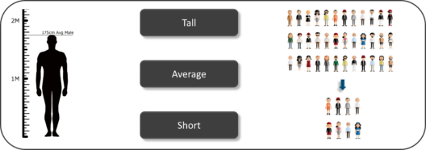
Inferential Statistics
So, if we consider the same example of finding the average height of students in a class, in Inferential Statistics, you will take a sample set of the class, which is basically a few people from the entire class. You already have had grouped the class into tall, average and short. In this method, you basically build a statistical model and expand it for the entire population in the class.

Slide 18
Understanding Descriptive Analysis
When we try to represent data in the form of graphs, like histograms, line plots, etc. the data is represented based on some kind of central tendency. Central tendency measures like, mean, median, or measures of the spread, etc are used for statistical analysis.

Slide 19
Understanding Inferential Analysis
Statisticians use hypothesis testing to formally check whether the hypothesis is accepted or rejected. Hypothesis testing is an Inferential Statistical technique used to determine whether there is enough evidence in a data sample to infer that a certain condition holds true for an entire population.
To under the characteristics of a general population, we take a random sample and analyze the properties of the sample. We test whether or not the identified conclusion represents the population accurately and finally we interpret their results. Whether or not to accept the hypothesis depends upon the percentage value that we get from the hypothesis.

